Slide 1
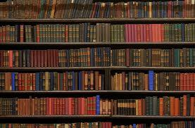
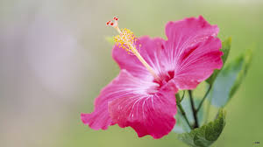
Welcome to the presentation of JSC English First Paper.
I am Md Hasan Hafizur Rahman, Lecturer (English), Cambrian School & College, Dhaka, going to conduct the class with you.

Slide 2
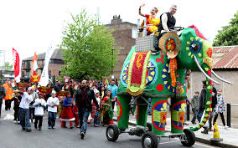
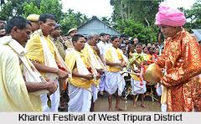
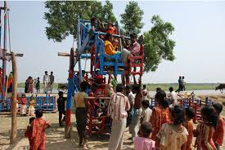
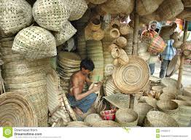
Let us watch some images.
Boishakhi fair
Choitra mela
Village fair
Cottage fair

Slide 3
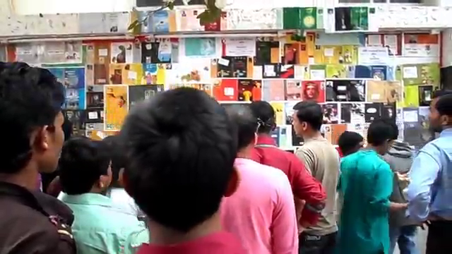
But what is this?
It
is
a
book
fair

Slide 4
Let’s see, what is our today’s lesson?
It is a paragraph
“ A Book Fair”
Writing part.

Slide 5
Learning outcomes
After we have studied this unit we will be able to-
listen information
know about a book fair
ask and answer questions
write a paragraph.

Slide 6
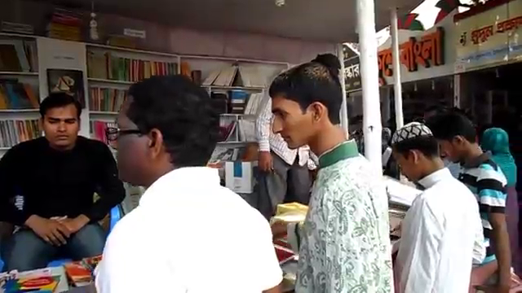
Let us enjoy a video.
What is the video about?
It is about a book fair.

Slide 7
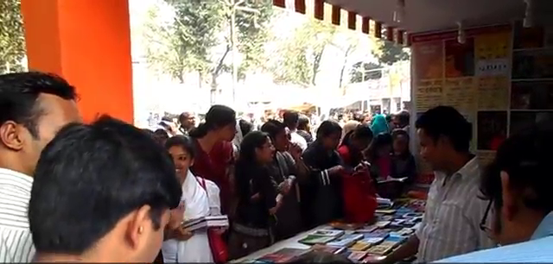
What is a book fair?
Book fair is a fair where books are displayed and sold.

Slide 8
When and where is it held in our country?
It is held all over the
country in February.

Slide 9
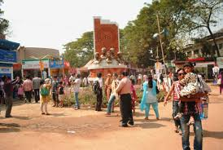
Where is the biggest book fair held in our country?
The biggest book fair in our country is held at Bangla Academy, Dhaka.

Slide 10
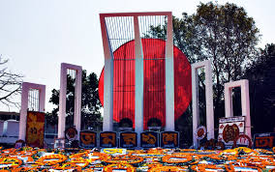
What is the starting and ending time of
the book fair?
It starts on1 February and ends at the last February.
1
28

Slide 11
It is started with an inaugural ceremony.
But how is it started?

Slide 12
Who attends as the
chief patron of the ceremony?

Slide 13
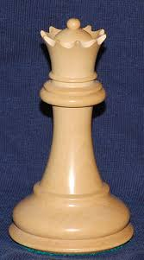
President
Prime Minister
Sometimes the President, sometimes the prime minister and sometimes the education minister attends as the chief patron of the ceremony.

Slide 14
When and Which book fair did you visit?
I visited the Ekushey book fair last year with some of my friends.

Slide 15
What things did you visit in the book fair?
In the book fair I visited more than hundreds of stalls set up in different rows. All the stalls were laden with different books like-

Slide 16
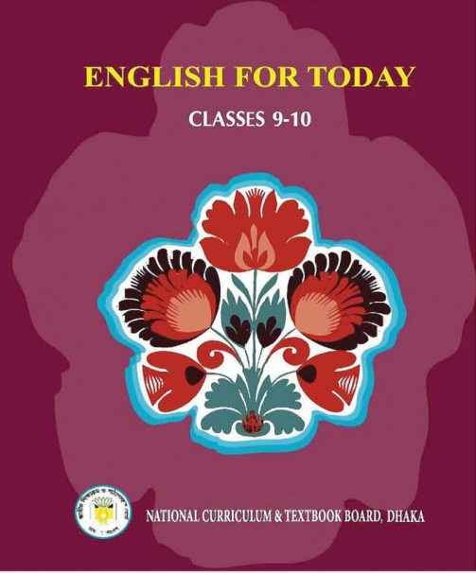
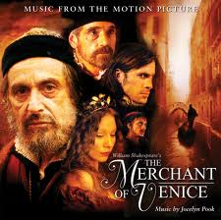
text books
story books

Slide 17
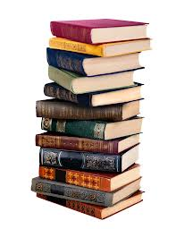
books on geography
books on history

Slide 18
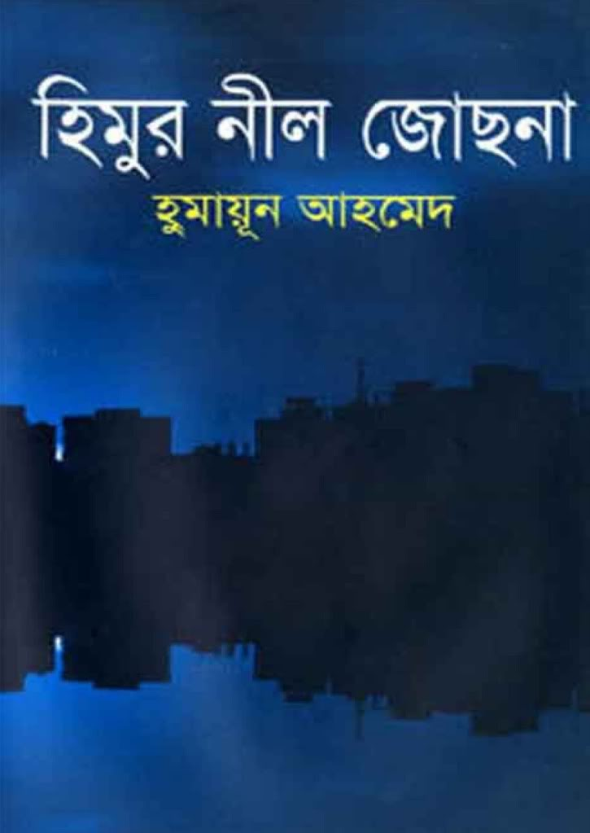
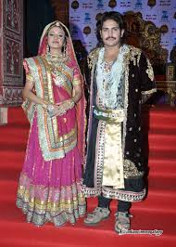
novels
books on drama
Akbar the great

Slide 19
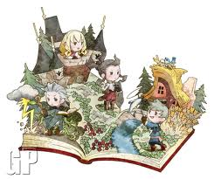
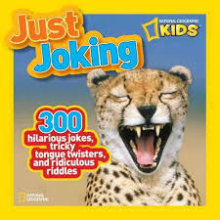
children books
books on jokes

Slide 20
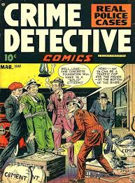
ghost books
detective books

Slide 21
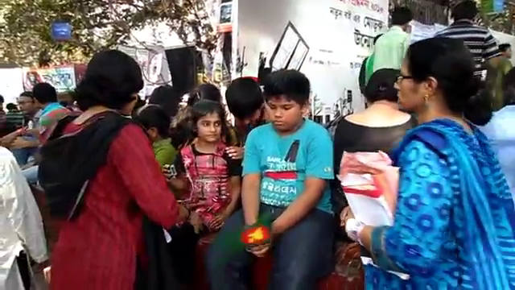
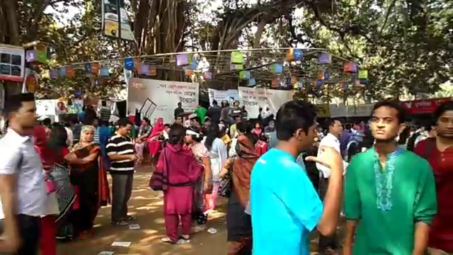
Who came to the book fair?

Slide 22
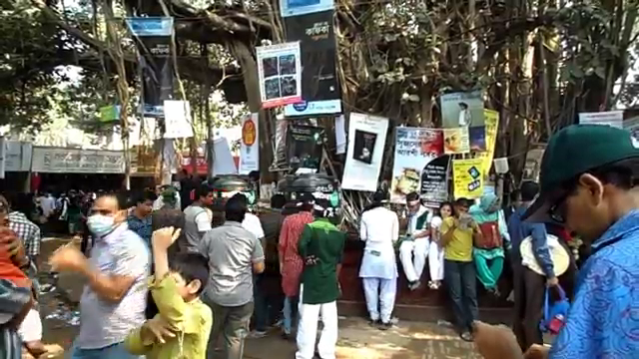
All classes of people came to the book fair.

Slide 23
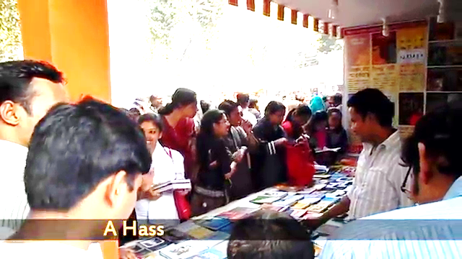
Some of them came to visit only and some of them came to buy books.
But why did they come
to the book fair?

Slide 24
I bought some books on story, novels and some religious books.
Did you buy any book yourself?

Slide 25
What did you visit more?
There was an arrangement of month-long cultural program. I enjoyed a cultural program participated by famous writer Imdadul Haque Milan.

Slide 26
What was most interesting to you?
Luckily I got an opportunity to meet with the writer. He told me about some interesting events of his life that made him writer. I was influenced with his words very much.

Slide 27
What is your thinking about the book fair?
A book fair is very important because it helps to increase our knowledge, it broadens our outlook, it teaches us morality, simplicity, humanity and other qualities. So we should encourage people specially the students of schools and colleges to go to the book fair

Slide 28
How much did you enjoy the book fair and what is your feelings about it?
I enjoyed the book fair very much and I will
never miss the book fair as long as I live my life.

Slide 29
Group Work
Make a logical assemble with book, stalls, people, cultural function, writer, text, novels, drama and so on to write a paragraph on a book fair.

Slide 30
Evaluation
What is a book fair?
When is it arranged?
Who attends the book fair?
Why do the people come to the book fair?
What is the importance of a book fair?

Slide 31
Universal
Your nears and dears
may leave you in
time of danger
but a book
never
leaves
you.
.

Slide 32
Home work
Write a paragraph on
“A book Fair You Visited”

Slide 33
Allah Hafez

Slide 34
A Book Fair
Book fair is a fair where books are displayed and sold. It is held all over the country in February. The biggest book fair in our country is held at Bangla Academy, Dhaka. It starts on1 February and ends at the last of February. It is started with an inaugural ceremony. Sometimes the president, sometimes the prim minister and sometimes the education Minister attends as the chief patron of the ceremony. I visited the Ekushey book fair last year with some of my friends. In the book fair I visited more than hundreds of stalls set up in different rows. All the stalls were laden with different books like text books, story books, books on geography, history, ,jokes, novels, drama, detective books, children books, religious books, Quran and Hadith, ghost books and so on. All classes of people came to the book fair. Some of them came to visit only and some of them came to buy books. I bought some books on story, novels and some religious books. There was an arrangement of month-long cultural program. I enjoyed a cultural program participated by famous writer Imdadul Haque Milan. Luckily I got an opportunity to meet the writer. He told me about some interesting events of his life that made him writer. I was influenced with his words very much. A book fair is very important because it helps to increase our knowledge, it broadens our outlook, it teaches us morality, simplicity, humanity and other qualities. I enjoyed the book fair very much and I will never miss the book fair as long as I live my life.

